Slide 1

CS1010
https://github.com/DigiPie/cs1010_tut_c09

Slide 2
Today’s plan
Tutorial Segment
Unix & Clang
Recap on C
Discussion of problem sets
Lab Segment
Programming Assignment (PA0)

Slide 3

KAHOOT!
Quick quiz

Slide 4
Unix commands
https://nus-cs1010.github.io/1819-s1/unix/index.html
http://cheatsheetworld.com/programming/unix-linux-cheat-sheet/

Slide 5
Compiling with Clang
clang -Wall -g teh.c -o teh –lm
What is –Wall? Enable Warnings All
What is –g? Generate additional info for lldb debugger
What is –o teh? Output file name set to teh
What is –lm? Link to Math library
https://nus-cs1010.github.io/1819-s1/clang/index.html

Slide 6
Today’s plan
Tutorial Segment
Unix & Clang
Recap on C
Discussion of problem sets
Lab Segment
Programming Assignment (PA0)

Slide 7
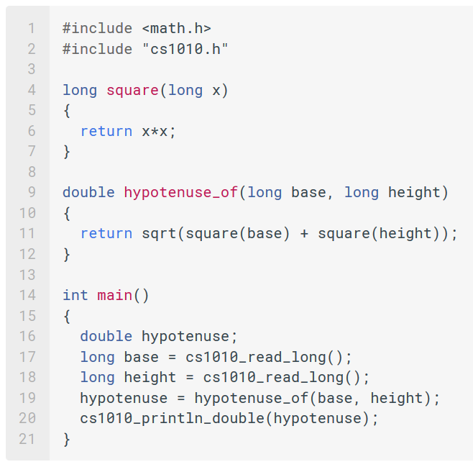
Recap on C

Slide 8
Today’s plan
Tutorial Segment
Unix & Clang
Recap on C
Discussion of problem sets
Lab Segment
Programming Assignment (PA0)

Slide 9
Problem sets
3.1, 3.2, 5.1, 5.2

Slide 10
Problem Set 3.1
MAD: How spread out a set of data is.
Absolute deviation: Absolute difference between an element and the mean.
MAD: Mean of all absolute deviations.

Slide 11
Problem Set 3.1
Given the following functions: mean(L, k), subtract(L, k, s), abs(L, k), how do you solve this problem?
L: List of elements; k: Number of elements in L
mean(L, k): Returns mean of list L
subtract(L, k, s): Subtracts s from every element in L
abs(L, k): Absolutes every element in L

Slide 12
Problem Set 3.1
Find the mean:
mean(L, k)
Subtract the mean from every element
subtract(L, k, mean(L, k))

Slide 13
Problem Set 3.1
Absolute every element in the list:
abs(subtract(L, k, mean(L, k)), k)
Find the mean again
mean(abs(subtract(L, k, mean(L, k)), k), k)

Slide 14
Problem sets
3.1, 3.2, 5.1, 5.2

Slide 15
Problem Set 3.2 (a) Find the sum of all integers in L recursively
sum(L, i, j) {
if ( i == j ) {
return Li;
} else {
return Li + sum(L, i+1, j);
}
}

Slide 16
Problem Set 3.2 (b) The function pow(i,j) computes i^j. How do we compute recursively?
pow(2,3) returns 2^3 = 2 x 2 x 2 = 8

Slide 17
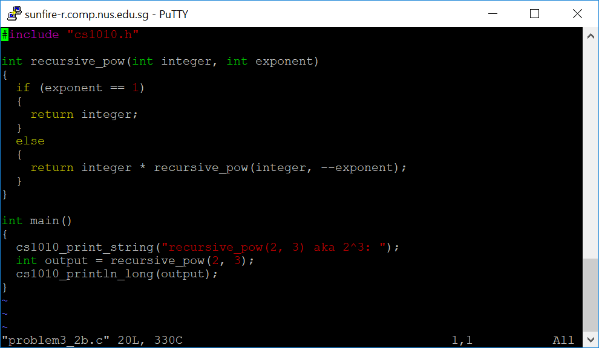

Slide 18
Problem sets
3.1, 3.2(b), 5.1, 5.2

Slide 19
Problem Set 5.1 Would passing an int into sqrt(…) result in an error?
double sqrt(double x);
double hypotenuse_of(long base, long height) { return sqrt(square(base) + square(height)); }

Slide 20
Problem Set 5.1 No, because any double can hold any int.
double sqrt(double x);
double hypotenuse_of(long base, long height) { return sqrt(square(base) + square(height)); }
Notes:
Since double can hold any int value within its range, assigning int to double does not incur any information loss. The other way, however, would cause the value to be truncated.

Slide 21
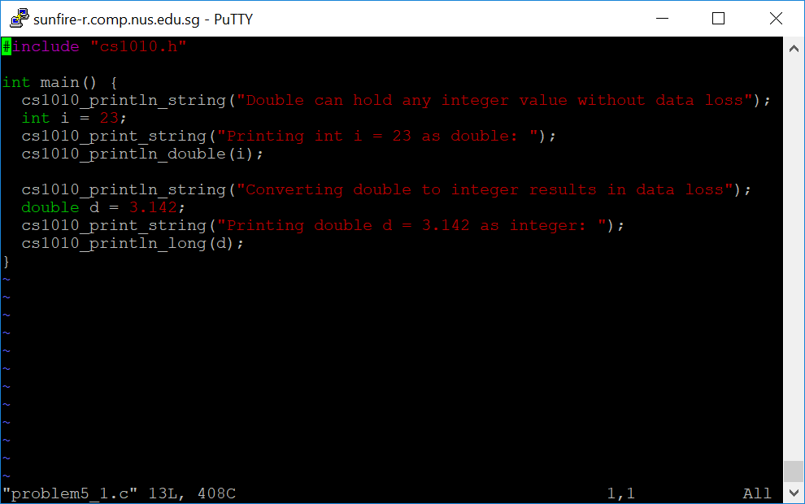
Problem Set 5.1

Slide 22
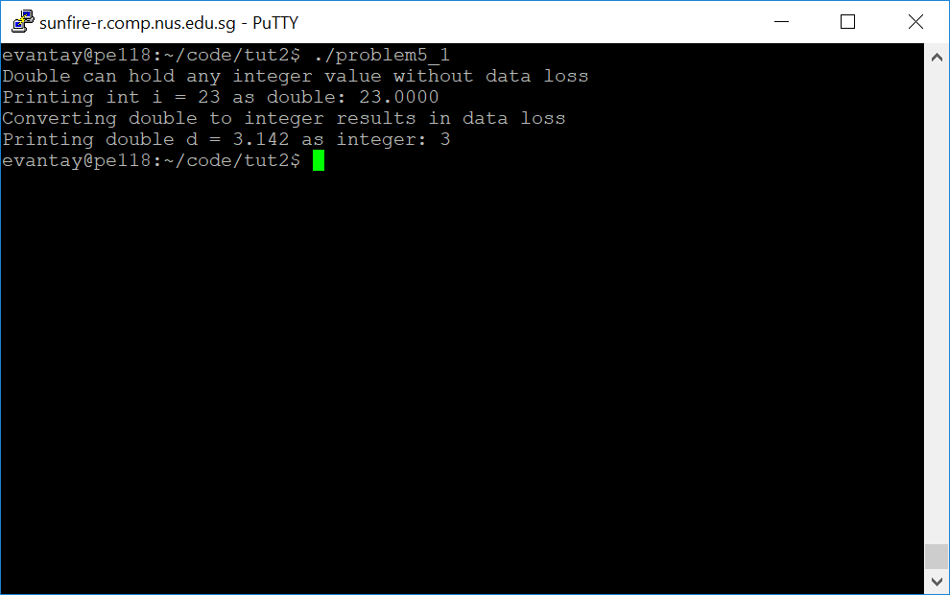
Problem Set 5.1

Slide 23
Code available here
https://github.com/DigiPie/cs1010_tut_c09

Slide 24
Problem sets
3.1, 3.2(b), 5.1, 5.2

Slide 25
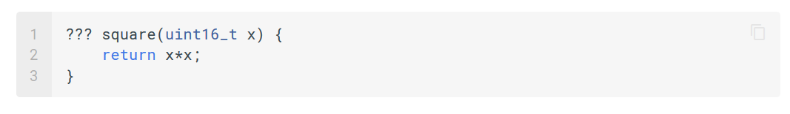
Problem Set 5.2 What return type should we use?
Max value of input is 2^16 – 1 = 65,535
(limited by uint16_t parameter)

Slide 26
Problem Set 5.2 What return type should we use? Must be big enough to store all possible values of x * x
Max value of input is 2^16 – 1 = 65,535
(limited by uint16_t parameter)
Can we use uint16_t for return type?

Slide 27
Problem Set 5.2 What return type should we use? Must be big enough to store all possible values of x * x
Max value of input is 2^16 – 1 = 65,535
(limited by uint16_t parameter)
Can we use uint16_t for return type? No
What if input was 65, 535?
Notes:
We cannot use uint16_t for return type because if input is 65,535, the return value will be 65,535 x 2 > 65,535

Slide 28
Problem Set 5.2 What can the return type of this square be, in order for the return type to be big enough to store all possible values of x * x?
Max value of input is 2^16 – 1 = 65,535
(limited by uint16_t parameter)
Can we use uint32_t for return type?

Slide 29
Problem Set 5.2 What can the return type of this square be, in order for the return type to be big enough to store all possible values of x * x?
Max value of input is 2^16 – 1 = 65,535
(limited by uint16_t parameter)
Can we use uint32_t for return type? Yes
(2 ^ 32) – 1 > ((2 ^ 16) – 1) ^ 2
Notes:
We can because uint32_t’s largest value is 2^32 – 1 > (2 ^ 16 – 1) ^ 2

Slide 30
Problem Set 5.2 What can the return type of this square be, in order for the return type to be big enough to store all possible values of x * x?
Max value of input is 2^16 – 1 = 65,535
(limited by uint16_t parameter)
Can we use int32_t for return type?

Slide 31
Problem Set 5.2 What can the return type of this square be, in order for the return type to be big enough to store all possible values of x * x?
Max value of input is 2^16 – 1 = 65,535
(limited by uint16_t parameter)
Can we use int32_t for return type? No
Range is from – (2 ^ 16) to (2 ^ 16) - 1
Notes:
No because the max value of int32_t is actually 2^16 – 1, this is because half of the bits are used for negative integers and the other half are used for positive integers.

Slide 32
Today’s plan
Tutorial Segment
Unix & Clang
Recap on C
Discussion of problem sets
Lab Segment
Exercise 1: Freezer.c

Slide 33
Q & a

Slide 34
THE END
https://github.com/DigiPie/cs1010_tut_c09

